Slide 1
Minnesota State
OER Faculty Development
Learning Circles
December 14, 2020
Massachusetts Department of Higher Education
Karen Pikula, PhD, Central Lakes College, Minnesota State
Karen.pikula@minnstate.edu

Slide 2
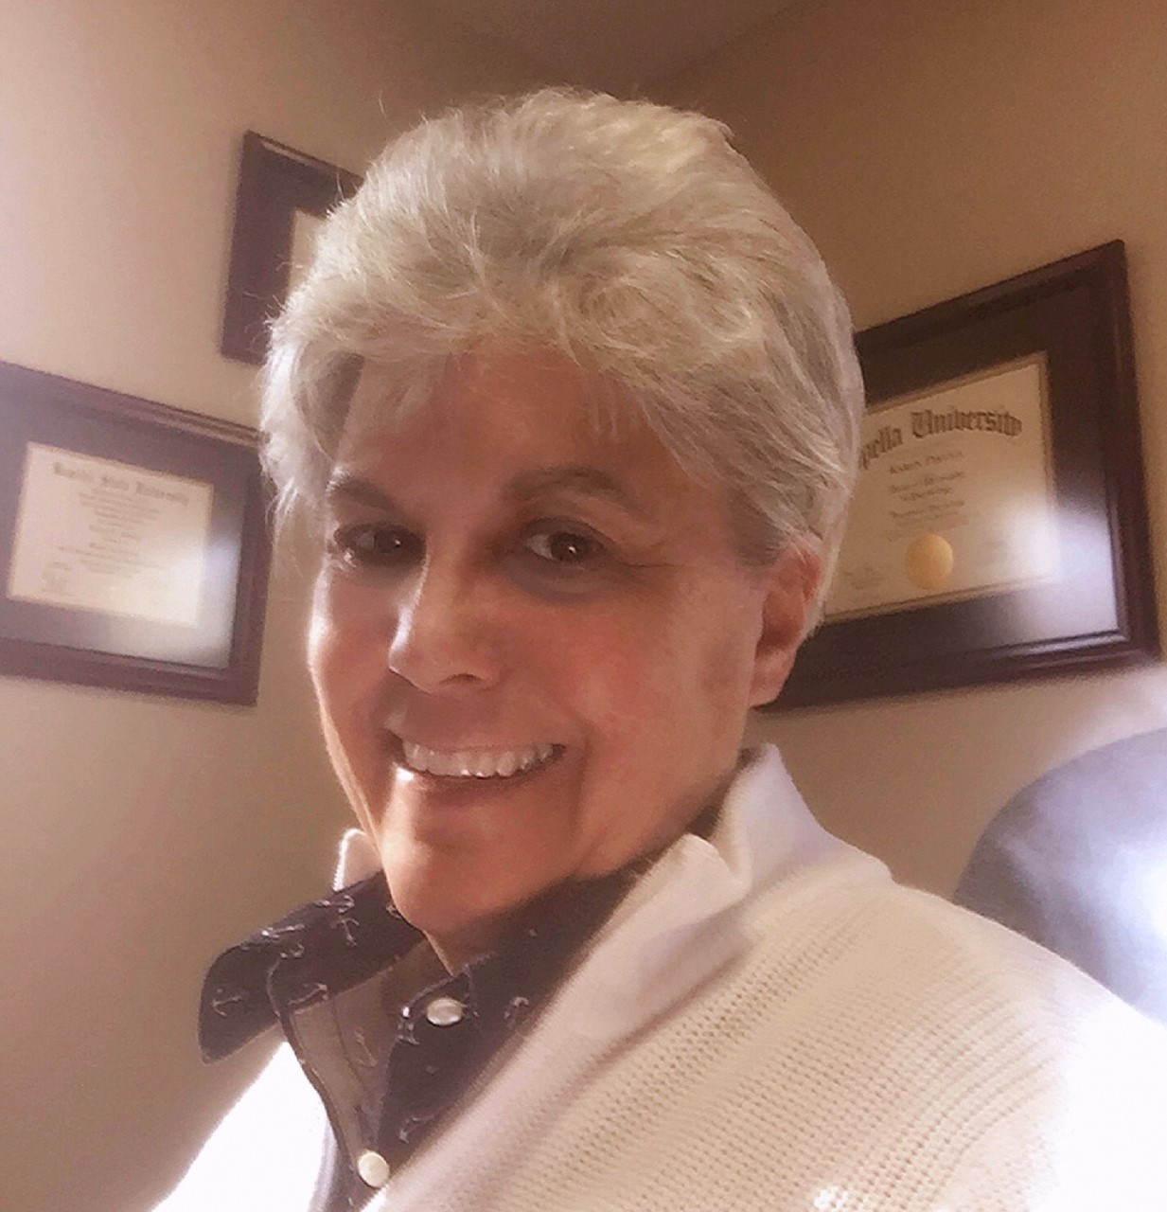
Dr. Karen Pikula is a Psychology instructor at Central Lakes College in Brainerd Minnesota and serves as the OER Faculty Development Coordinator for Minnesota State Colleges and Universities. Her professional interests include instructional design, faculty development, student centered learning, open educational resources, open pedagogy, online instruction, teacher attrition, student success, and research on the practices of successful 21st century colleges. She holds a MS in Education from Bemidji State University and PhD from Capella University in Educational Psychology.

Slide 3
OER Faculty Development Learning Circles
A Module for Success…
Minnesota State OER Faculty Development Learning Circles offer Minnesota State faculty the opportunity to structure and organize their OER work in a resource rich,
cross disciplinary, cross institutional, peer, librarian, and facilitator supported, collegial work environment.
Notes:
Welcome:
Slide # 3 Model for Success…
I would like to first of all thank Tanya and the Open Education Network for inviting us to share our experiences with OER Faculty Development Learning Circles with you today!
I would also like to thank each of you for taking time from your busy day to join us for this conversation!
Today six faculty from Minnesota State will be sharing their OER Learning Circle experiences with you.
As you hear each of the six faculty introduce themselves, and share their stories, please note their names, and also any comments, or questions that come to mind as you listen to them speak. We have reserved a nice chunk of time after each faculty has shared for you to ask questions or comment.
As you can see from this slide, we have found this OER Learning Circle model to be A MODEL FOR SUCCESS!
The structure and the process of the model offer faculty an opportunity to structure and organize their OER work in a resource rich, cross disciplinary and cross institutional, collegial work environment.

Slide 4

The Structure
Three Pathways
Faculty work in facilitated, cross disciplinary, collaborative, Learning Circles. Semester Learning Circles for 10 weeks
Summer Sessions 5 weeks
Meet for one hour per week in virtual Zoom Room Learning Circles, where they share “Pearls” thoughts, ideas, questions.
Have access to a Brightspace (D2L) Faculty Support
Course Room
Participants share ideas and support each other through their chosen Learning Circle Pathway.
Faculty on all pathways must attend at minimum 80% of the scheduled Learning Circle meetings.
Participants share their final projects at a wrap-up Showcase Event.
Authoring:
Ancillary Materials
Textbooks
Course Redesign
OER Learning Circle Leader
Practicum
Notes:
Slide # 4: Structure…
The LC’s are structured as 10 week sessions for semesters, and as 5 week sessions for summer session.
The LC’S are structured around three project pathways.
Course Redesign
Authoring of ancillary materials or textbooks
OER LC Leader’s Practicum
Faculty meet for one hour per week in virtual facilitated Zoom Room Learning Circles.
Here faculty:
Share a “Pearl” (which is their “AHA” enlightenment, from their work that week. They also share thoughts, ideas , questions, great resources.
Faculty are expected to attend 80% of the scheduled Learning Circle meetings.
Share end product at a end of session Showcase Event.

Slide 5
The Process…
Faculty create unique and individualized work plans for their semester of work.
Faculty maintain weekly journals that are an integrated part of their work plan.
(Notes to themselves on resources, questions, plans for future work etc. )
Their plan is a tentative plan and will evolve as faculty work.
This plan is an essential element for success. It gives faculty a tangible scope and sequence for their work … it lessens their anxiety about project completion…and it holds them accountable to a self-designed and owned workplan!
Faculty also have access to optional weekly discussion forums where they can ask peers for help, share ideas, resources they have discovered, and their weekly “Pearl”.

Slide 6
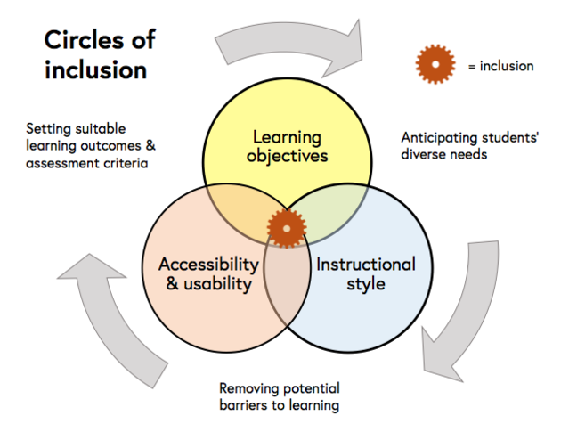
Minnesota State OER Faculty Development Learning Circles
https://ugc.futurelearn.com/uploads/assets/66/bd/hero_66bd78f6-e398-45db-ad9b7910bd237988.png

Slide 7
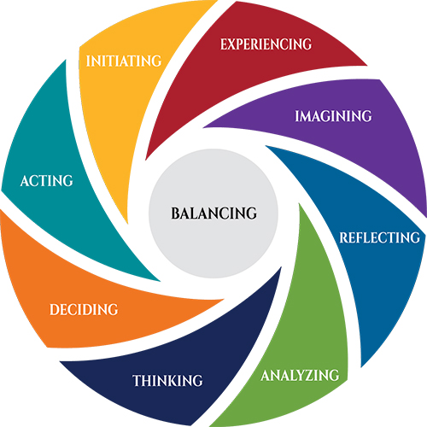
Learning Circle Model
Built Around Experiential Learning Theory
https://www.experientiallearninginstitute.org/wp-content/uploads/2016/11/StyleNamesNEW.jpg

Slide 8
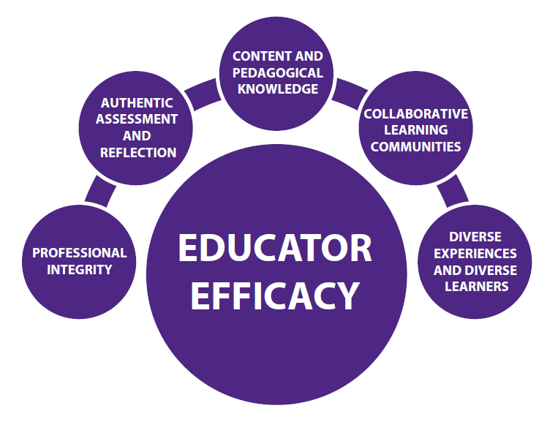
OER Learning Circles:
Promote and nurture educator efficacy
Faculty supporting each other on projects to:
  Re-design courses around free or low-cost materials for students
  Develop ancillary materials to accompany existing open textbooks
  Author open textbooks for developmental education or transfer pathways courses
Participation leads to:
      1. Expanded use of OERs and
      documenting reduced costs for
      students
  2. Creation of resources to be shared
  with others
  3. Collaborating and building
  relationships across colleges and
  universities
  4. Become OER ambassadors on their
  campuses and for the system
https://uca.edu/education/files/2015/07/Conceptual-Framework-2015-Web.png

Slide 9

Learning Circle Process
Participants are paid a stipend for their work…
The OER textbook review pathway stipend is between $200.00 - $500.00
Both the course redesign pathway and the authoring pathway recipients receive $1500.00 stipends for their work.
Librarian driven initiative
Increases faculty awareness of OER opportunity
Increases adoption of OER’s
Faculty attend 80% of scheduled Learning Circle meetings.
Faculty create, submit, and update weekly workplans and journals.
Faculty present their final work results to colleagues.

Slide 10

Application Process:
Scoring criteria:
Course is needed for Z Degree
Course is scheduled to be taught in the next academic year
Course is high enrollment (> 50 students per year)
Faculty is new to OER Learning Circles
Application sustains current OER course
Current cost of textbook
Savings to students if course is redesigned as an OER course
How redesign benefit students?
Benefit other Minnesota State faculty?
Course is a Developmental Ed Course
Consider the content area
Ancillary materials complement an existing open textbook (Housed in the Open Textbook Library, BC Open Textbook Collection, or other repositories
Interested faculty apply to attend Learning Circles…
Institutional Level: OER committee reviews applications announce successful applicants.
System Level: OER Coordinator and Program Director for Educational Development review applications and announce successful applicants.

Slide 11

Collaborative Learning Circles
Interactive support for faculty as they work through each of three pathways…

Slide 12
Three Pathways
OER Review (Only at institutional level)
OER Course Redesign
OER Authoring
OER Leader Learning Circles

Slide 13
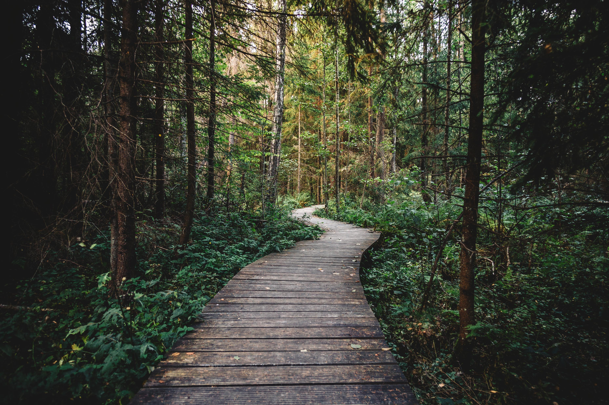
Review, Redesign, and Authoring Pathways
Faculty work in facilitated, cross disciplinary, collaborative, Learning Circles where they share
ideas and support each other and must attend a minimum of 80% of the scheduled
Learning Circle meetings where they share weekly their “Pearls” (also post in the weekly in discussion forums.)
Faculty in the Redesign and Authoring Pathways create a 10-week work plan detailing the process they plan to use in the creation of their OER courses and resources.
Faculty in the Review Pathway create a 5-week work plan detailing the process they plan to
use in the creation of their OER resource/s. Their plans will change, so they do not have to be perfect.
Review Pathway: identify OER resources to adopt.
Redesign Pathway create a D2L course shell using their selected OER materials or create a hard copy portfolio of content, objectives, and assessments, for their course.
Authoring Pathway create either ancillary resources to accompany existing OER resources or they author a textbook for their course.
BONUS: Many faculty redesign their course and then also end up authoring a textbook.
Authoring Pathway download and read the Authoring Guide from BC Campus. https://opentextbc.ca/opentextbook/
All pathways share their completed projects with the other participants at the final scheduled Learning Circle Showcase Event.
All courses or newly created materials are given Creative Commons Licenses.

Slide 14

Brightspace (D2L) Faculty Support
Course Room
Structured weekly modules for each of the three pathways
Repository of resources
Universal Design links
QM support and links
Case studies
Organizational structure for faculty work
Opportunity to share and discuss “Pearls” from individual
experiences.

Slide 15

Amazing Discovery!!!
Faculty addressing accessibility, equity, diversity
https://www.google.com/search?client=firefoxab&biw=1280&bih=584&tbm=isch&sa=1&ei=9b8WW7i1DavNjwTwsoSQCA&q=aha+moment&oq=aha+moment&gs_l=img.3..0l10.14988.24401.0.25401.21.16.0.0.0.0.325.1249.8j3j0j1.12.0....0...1c.1.64.img..9.4.641...0i67k1j0i8i30k1j0i24k1.0.v-AcLexhvGw#imgrc=kOn2Te4DasjjbM:

Slide 16
Examples
Ancillary Materials
    Test banks
    Lab manuals/ Lab activities / Chemistry / Biology :Chemistry
    Assignment guidelines text to supplement textbook
    Chapter links to multimedia content
    Multiple file formats for test banks
    Powerpoints
    Study Guides
    Quizzes
    Media literacy components
    Chapter revisions
    Activities/ Handouts/ Vocabulary lists/
    Assessments
    Narrated presentations
    A portfolio of Intermediate Algebra resources
    Multi media integrated through Lodestar/ Student centered
    examples & diverse videos/“Virtual Student” & “case
    studies”/Shared via D2L & Lodestar Learning Objects &
    Word, / Video & PowerPoint
    Manual to assist teachers in managing collaborative transmedia storytelling projects.
3 new textbooks
      Building Academic Literacy
    YOU: Writing! A First-Year Composition Textbook
    Microbiology Textbook (6 Chapters)
    Bonus:
    Course Redesign ends up a textbook!
    Introduction to Philosophy: Words of Wisdom
Course Redesign
    ADSC1031 - Business English Skills
    MUS2201 & MUS2202 - Music Theory & Musicianship I & II
    HLTH1150 – Wellness
    Bonus: Course Redesign ends up as a
    Chemistry Lab Manual

Slide 17

Superb Resources …plus…
  Collaboration:
  Between Universities and Colleges
  Between faculty in Learning Circles and faculty in departments across the state
  Interdepartmental consulting on projects/peer review
Personal Professional Growth and Development
Faculty regain confidence in their own personal professional expertise.
    Journal Reflection
    “This is crazy cool. I have learned so much. I have been able to start a
    few academic papers, plus pull from some old drafts I have, to work
    on a chapter on “Style”—I didn’t know this OER textbook project was
    going to help my career so much!”

Slide 18
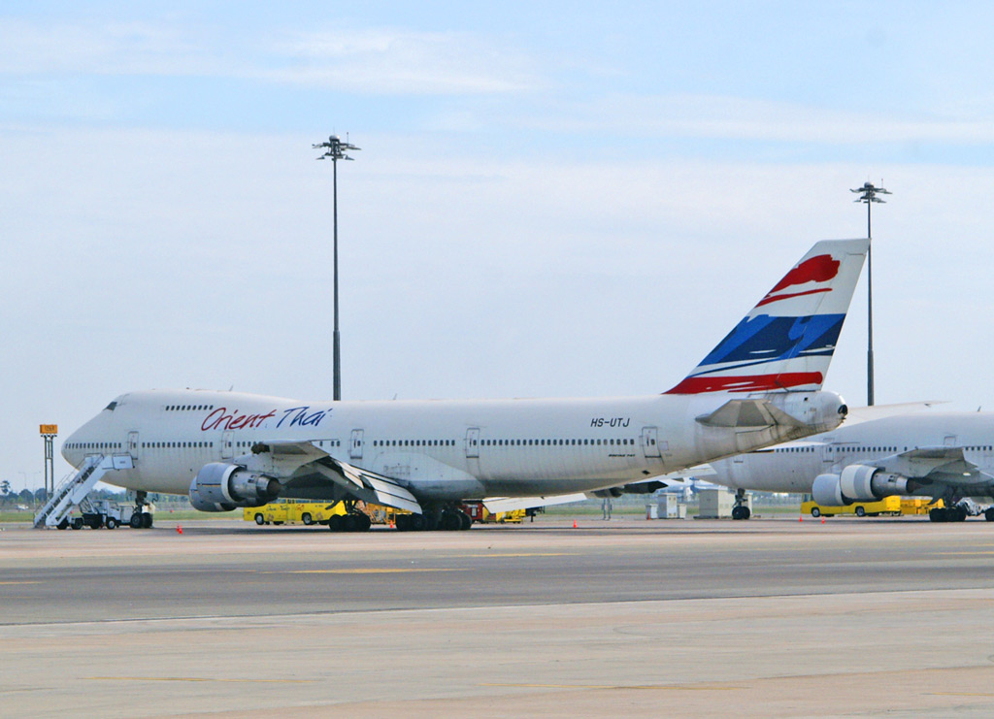
In Practice…
Open pedagogy: is the practice of engaging with students as creators of information rather than simply consumers of it.
It's a form of experiential learning in which students demonstrate understanding through the act of creation.
David Wiley’s Analogy…
Using open in the same ways we have traditionally used commercial learning resources….is like…
Blog written and maintained by David Wiley.
iterating toward openness
pragmatism before zeal
https://opencontent.org/blog/archives/2975
Improving Student Success…
Student success is the goal. Everything else is a means to that end.
https://improvingstudentsuccess.org/
https://opencontent.org/blog/archives/2975
"Orient Thai Airlines Boeing 747 at Suvarnabhumi Airport, Bangkok" by UweBKK (α 77 on ) is licensed under CC BY-NC-SA 2.0

Slide 19
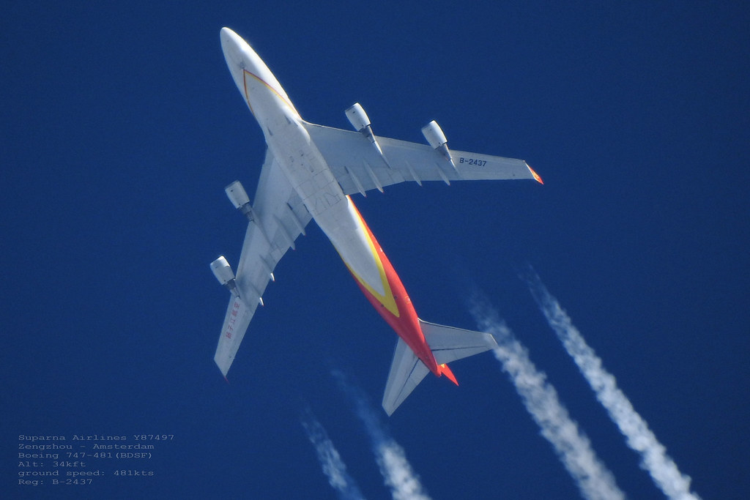
Imagine the view…
The Possibilities…
Using OER the same way we have used commercial textbooks misses the point…
Driving a 747 down the highway…
We can do it…
But the point of an airplane is to fly at hundreds of miles per hour – not to drive.
Driving an airplane around, simply because driving is how we always traveled in the past, squanders the huge potential of the airplane.
David Wiley
https://opencontent.org/blog/archives/2975
"taken from my backyard 083" by planes, space, nature is marked with CC PDM 1.0

Slide 20
David Wiley: Killing the Disposable Assignment…
The question becomes, then, what is the relationship between these additional capabilities and what we know about effective teaching and learning?
How can we extend, revise, and remix our pedagogy based on these additional capabilities?
There are many, many potential answers to this question…

Slide 21
Potential…
So… if we compare commercial textbooks and OER?
Commercial: limited ability to use, adapt, distribute…
OER …
Free to access
Free to reuse
Free to revise
Free to remix
Free to redistribute
https://opencontent.org/blog/archives/2975

Slide 22

ACADEMIC FREEDOM !
"Freedom" by Kliefi is licensed under CC BY-NC-SA 2.0
Allows instructors:
To create content specific to their learning outcomes.
To create content specific to their teaching style.
To create content specific to their teaching philosophy.
To create content specific to their learners needs.
To co- create content with their learners! Open Pedagogy!

Slide 23
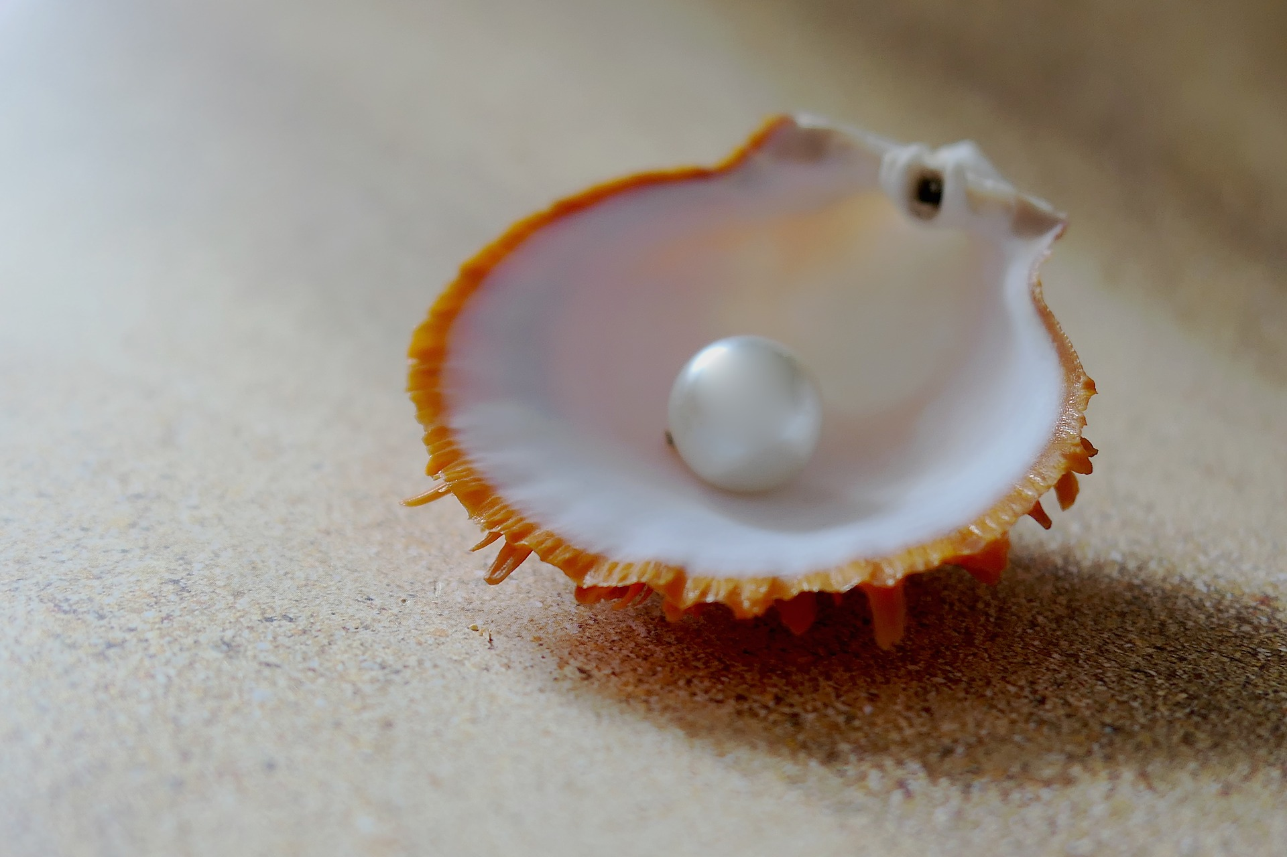
Beyond OER …
A Hidden “Pearl”!
Imageby<ahref="https://pixabay.com/users/moritz3201260270/?utm_source=linkattribution&amp;utm_medium=referral&amp;utm_campaign=image&amp;utm_content=3480818">moritz320</a> from <a href="https://pixabay.com/?utm_source=link-attribution&amp;utm_medium=referral&amp;utm_campaign=image&amp;utm_content=3480818">Pixabay</a>

Slide 24

The Learning Circle Process provides built-in opportunities for personal professional reflection and enhances the quality of the work that faculty are engaged in,
while promoting personal professional growth and renewed confidence in themselves as experts in their field.
http://www.religion-online.org/wp-content/uploads/2018/04/contemplation-2000x1200.jpg“Contemplation” by rhysohughes is licensed under Creative Commons

Slide 25

The Learning Circle Model …
Provides a process whereby faculty can actively engage in this paradigm shift within a supportive structure created to ensure success…
For themselves, and for their learners…
https://pixy.org/90463/

Slide 26

Questions
?

Slide 27
Thank you!
Karen.pikula@minnstate.edu
Attribution-NonCommercial-ShareAlike
CC BY-NC-SA

